Slide 1
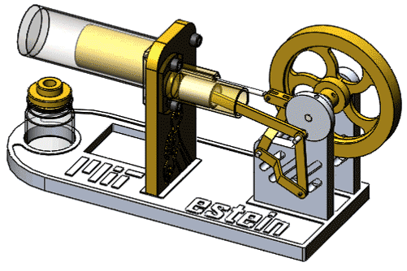

Stirling Engine
SE Dept.
ISE Dept.
Students: Yahia Showgan
Natali Showgan
Supervisor: Ms. Moran Kupfer
Date: 04.07.19
Notes:
Natali: Hey, my name is Natali I’m from Information System Engineering Dept. and this is Yahia Showgan from Software Engineering Dept.
We’re here to present to you our project about Stirling Engines.

Slide 2
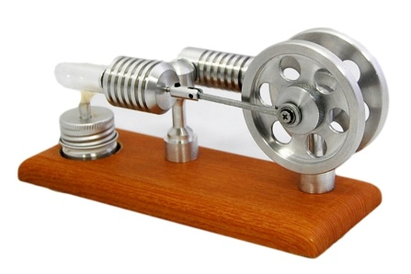
Introduction
Creating an application that receives data via sensors that are attached to a Stirling Engine and provides accurate required calculations.
Presenting the data in a visual display including graphs.
(Data is transferred from Pasco’s SW to excel file).
 | A Stirling Engine is a thermal engine with fixed amount of gas inside and can use any heat source to operate.
Notes:
Natali: A Stirling Engine is a thermal engine with fixed amount of gas inside and can use any heat source to operate.
In our project we are creating a software that receives data from the sensors attached to a stirling engine, and provides accurate required calculations.
That raw data is imported from an excel file that was transferred from the senor’s software.
After the calculations we will show the relevant data in a graphic display.

Slide 3
Motivation
Experiments done as part of Mechanical Engineering project on Stirling engines to find details of their performance had several challenges:
Extensive calculations had to be done manually
Final results weren’t accurate
Notes:
The Mechanical Engineering student (Danny) that offered the project suggestion, Is doing experiments on a Stirling Engine for his own project. In order to find details about an engine’s performance, he is doing all the required calculations using excel. It takes too much time and the results are not accurate. That’s why he reached to the software dept. for help.

Slide 4
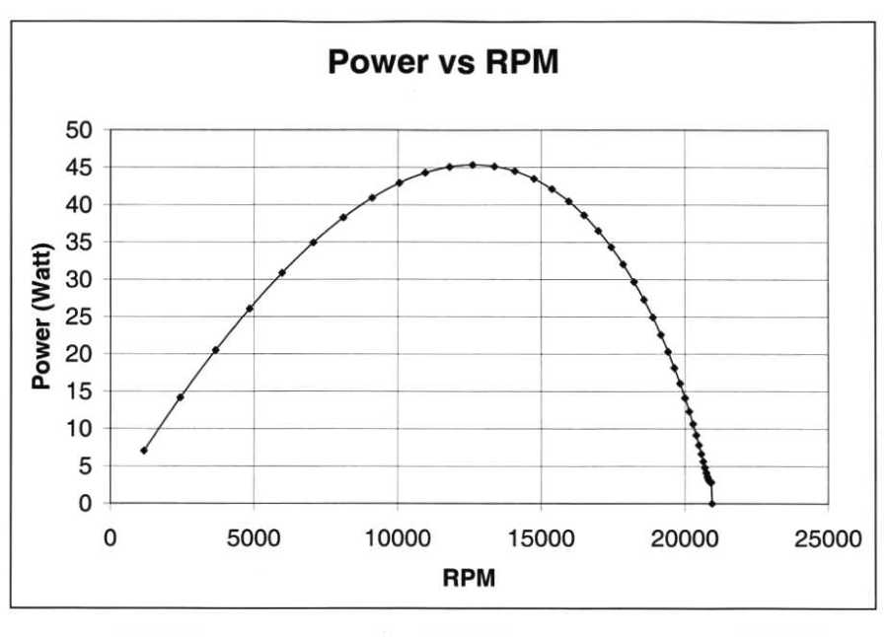
Goals
Find performance graph of an engine.
Finding the RPM that outputs maximum power.
Notes:
Our main goal In the project is to find an engine performance graph from the given raw data as accurately as possible and without taking too much time. The reason the performance graph is important is that it helps understand the engine’s performance on different RPMs and can be used to find which RPM produces the maximum power.

Slide 5
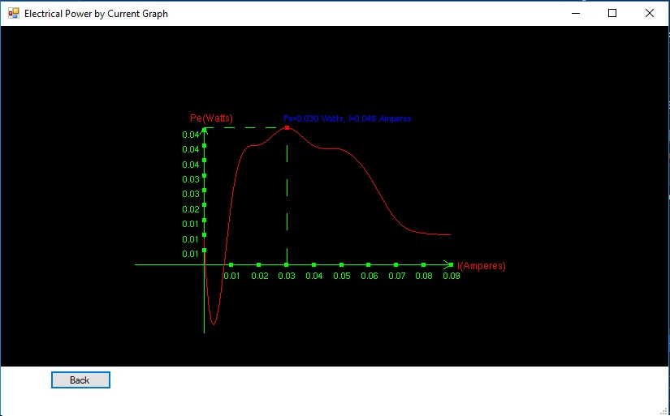
Find a graph of Electrical Power by Current:

Slide 6
Calculation Stages
Import
Calculate
Data
Filter & Sort
Find Work
Interpolate
Show Graphs

Slide 7
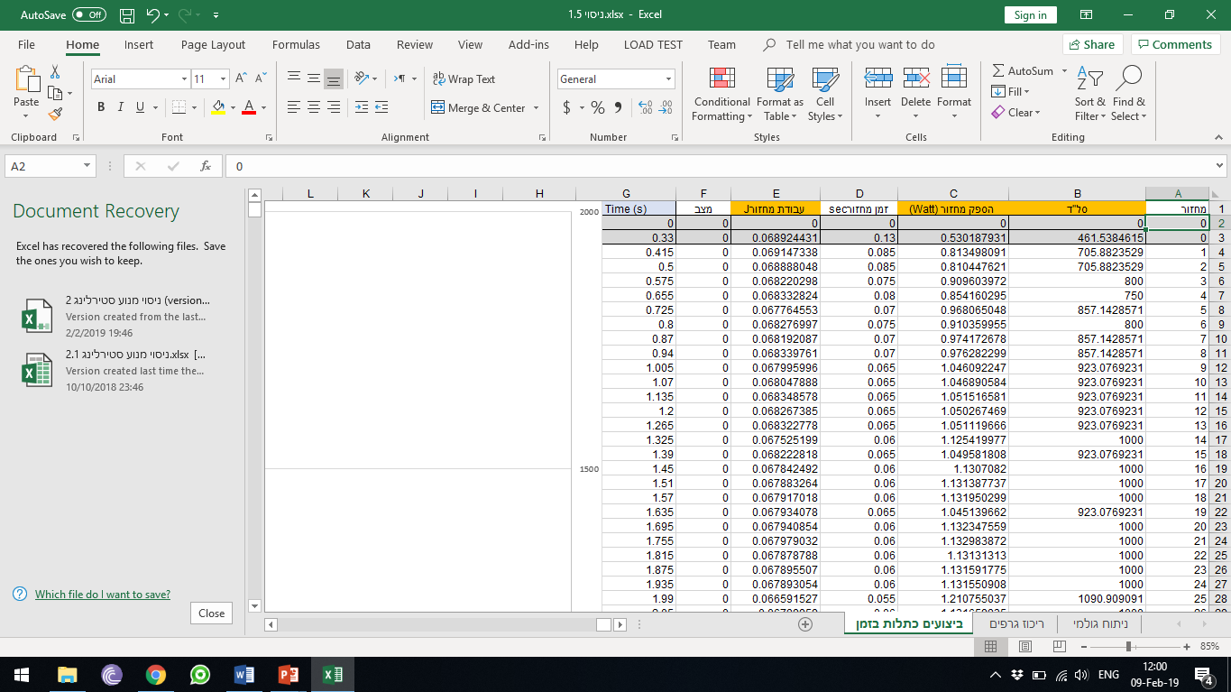
Stage 1:
importing the data from a csv file that was exported from Pasco’s software.
Notes:
In order to get the engine performance graph the data needs to go through these stages.
In the first stage we need to import the data from an excel file that was exported from Pasco’s software.
Pasco is the sensors manufacturer.

Slide 8
Calculation Stages
Import
Calculate
Data
Filter & Sort
Find Work
Interpolate
Show Graphs

Slide 9
Stage 2:
Calculate these values with various physics equations
Raw Data
Calculated Data
Voltage | Wattage | Current | Pressure | Degree | Time
1.1 | 1 | 0.01 | 175.7 | 0 | 0
1.2 | 1.2 | 0.011 | 175.9 | 0.04 | 0.005
1.24 | 1.3 | 0.016 | 180 | 0.1 | 0.01
1.3 | 1.5 | 0.019 | 180.6 | 0.12 | 0.015
Work Between Stages | Cylinder Volume | Normalized Degree | Cycle Stage | Cycle Num | Raw Data
0.5 | 0.21 | 0.01 | 1 | 1 | Data1
0.4 | 0.2 | 0.011 | 2 | 1 | Data2
0.6 | 0.22 | 0.016 | 3 | 1 | Data3
08 | 0.22 | 0.019 | 4 | 1 | Data4
Notes:
In the second stage, we need to calculate these values with various physics equations to get a table of calculated data.

Slide 10
Calculation Stages
Import
Calculate
Data
Filter & Sort
Find Work
Interpolate
Show Graphs

Slide 11
Stage 3:
Calculate RPM for each cycle, filter the cycles with 0 angular acceleration and calculate thermal power for those cycles.
Calculated Data
Cycles
Voltage | Wattage | Current | Pressure | Degree | Time
1.1 | 1 | 0.01 | 175.7 | 0 | 0
1.2 | 1.2 | 0.011 | 175.9 | 0.04 | 0.005
1.24 | 1.3 | 0.016 | 180 | 0.1 | 0.01
1.3 | 1.5 | 0.019 | 180.6 | 0.12 | 0.015
Work | Electrical Power | Thermal Power | Avg Angular Acceleration | Avg Angular Velocity | Cycle Time
 | 1 |  | 0 | 0 | 0.1
 | 1.2 |  | 0 | 0.04 | 0.11
 | 1.3 |  | 0 | 0.1 | 0.12
 | 1.5 |  | 0 | 0.12 | 0.09
Notes:
In the third stage we need to calculate the RPM for each cycle, then filter the cycles with 0 angular acceleration and calculate the thermal power for those cycles.

Slide 12
Calculation Stages
Import
Calculate
Data
Filter & Sort
Find Work
Interpolate
Show Graphs

Slide 13
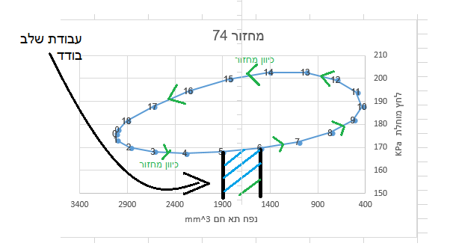
Stage 4:
Calculate the area of the below graph of Absolute Pressure by Volume in order to calculate the Thermal Work of a cycle
Notes:
In order to calculate the thermal power, we need to calculate the work first.
Using the graph of Pressure by Volume for a single cycle the work is equal to the area inside the graph.

Slide 14
Stage 4 (cont.):
To accurately calculate the area inside the graph we chose to interpolate the points to get a function that goes through them and then find the area inside.
Notes:
To calculate the area inside the graph accurately, we chose to interpolate the points on the graph and create a representing function, we then will use the function and calculate the area using Riemann Sum.

Slide 15
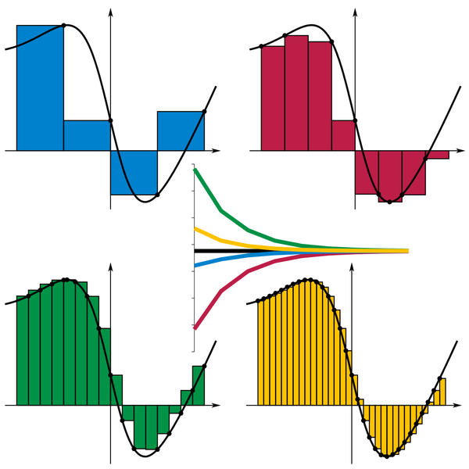
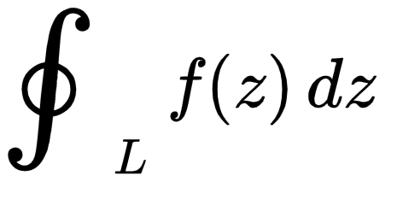
Stage 4 (cont.):
After finding a representing function, we will find the integral of our function that will be the area inside the circle.
Notes:
Once we have a function, we can use Riemann Sum to calculate the area, this is the formula for Riemann Sum which in our case can be calculated using an integral over a closed curve.

Slide 16
Stage 4 (cont.):
After calculating the Area we get the Cycle Work and divide it by Cycle Time to get Thermal Power of every cycle, Now we calculate an average of Cycle Power for the same RPMs.
Notes:
After finding the Cycle Work we divide it by the Cycle Time to get Thermal Power of every cycle.
Now we calculate an average of cycle power for cycles with the same RPM. We can create a graph of Power by RPM from those results which is the Performance Graph.

Slide 17
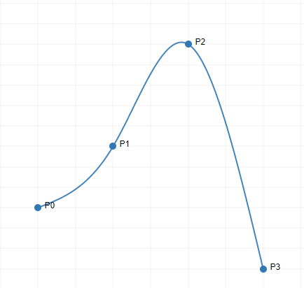
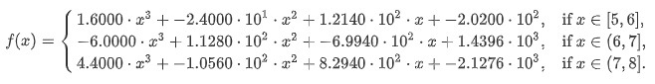
Stage 4 (cont.):
The interpolation method we chose to use is Cubic Natural Splines, this method calculates a set of polynomials between every 2 points that when together produces our function
For example for points- (5, 5) (6, 8) (7, 13) (8, 2) We get
Notes:
To interpolate the points we chose to use Cubic Natural Splines, this interpolation method produces a set of polynomials between every 2 points that together represents a function that goes through our points.
For example here’s a result of finding a function using the Cubic Natural Spline method, using these 4 points generates a function that consists of these 3 functions and this is the graph of it.

Slide 18
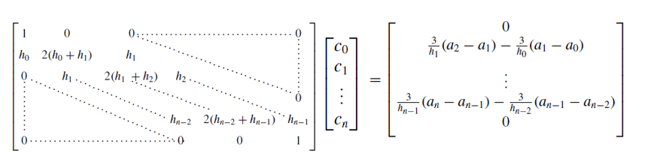
Interpolation Algorithm
S_{j}(x) = a_{j}+ b_{j}(x − x_{j}) + c_{j}(x − x_{j})² + d_{j}(x − x_{j})
a_{j+1} = S_{j+1}(x_{j+1})
b_{j−1} = 1/(h_{j}−1) ∙ (a_{j} − a_{j−1}) − h_{j−1}/3∙(2c_{j−1} + c_{j})
C_{j} remains the only unknown, once we calculate the system below, we can find our splines
From the Natural Cubic Spline definition we get these equations:
Our matrix is strictly diagonally dominant matrix, which can be calculated using Thomas’s algorithm in O(n) time
Notes:
This is the method of interpolation we’ll be using.
The Matrices are produced using our points.
What our application will need to do is, find a solution for this system of equations.
After finding the C’s in the vector we can then get the function representing each polynomial.
After we get the function, we integrate the function and find the area, which is the work.

Slide 19
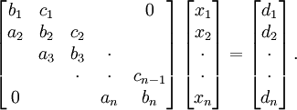
Thomas Algorithm
Forward elimination phase
loop: k=2 to n
m= a_{k}/b_{k-1}
b_{k}= b_{k}-m∙c_{k-1}
d_{k}= d_{k}-m∙d_{k-1}
end loop (k)
Backward substitution phase
x_{n}= d_{n}/b_{n}
loop: k = n-1 to 1
x_{k}= (d_{k}-c_{k}x_{k+1})/b_{k}
end loop (k)
Notes:
The algorithm we’ll be using to calculate the system is called Thomas Algorithm.
It can calculate the solution of a system with Tridiagonal Matrix in linear time.
A Tridiagonal matrix is a matrix with non zeros only on the 3 main diagonals.

Slide 20
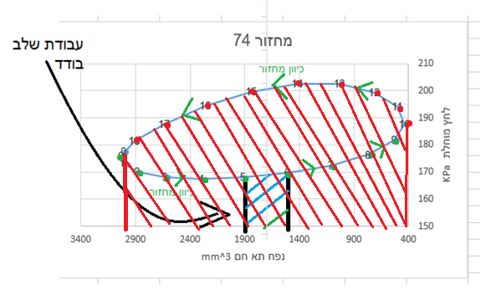
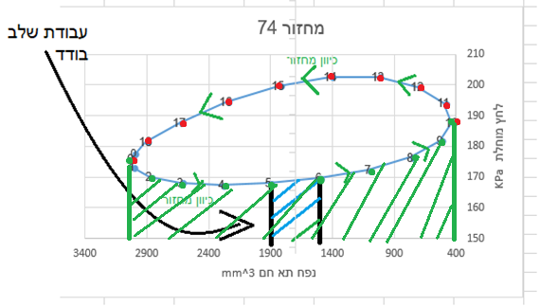
Stage 4 (cont.):
Because our interpolation only works for points with x in increasing order,
we decided to divide our points in to two groups, and find the upper function
(0,18,17,…,10)
and lower (0,1,2,…,10)
The difference is the area inside.

Slide 21
Calculation Stages
Import
Calculate
Data
Filter & Sort
Interpolate
Show Graphs
Find Work

Slide 22
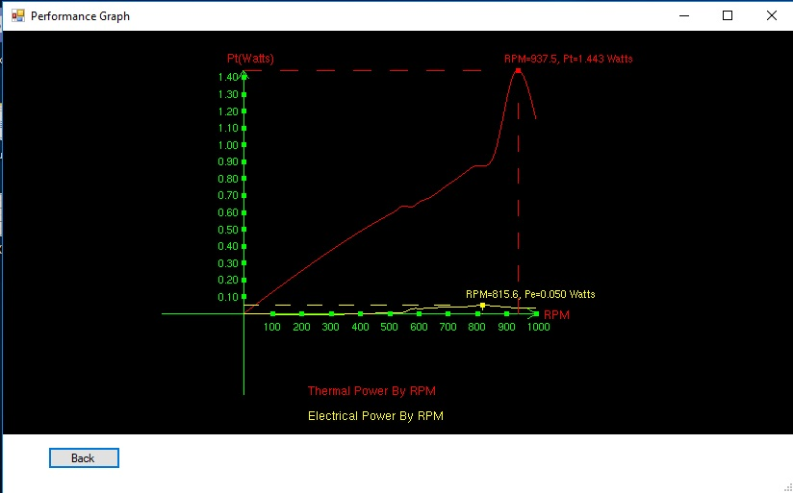
The Graphs
Engine Performance Graph
Electrical Power by Current Graph

Slide 23
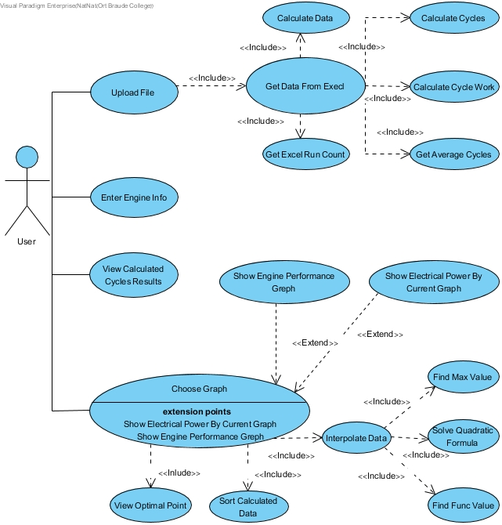
Use
Case
Diagram
Notes:
The user can do 3 actions.
he can import a test which includes getting the data from Excel, calculating the data and showing results.
Another thing the user can do is view the results.
The last action the user can do is show a graph that can be the performance graph or the electrical power by current graph. Showing the graph includes sorting the calculated data, data interpolation, and refining the data.

Slide 24
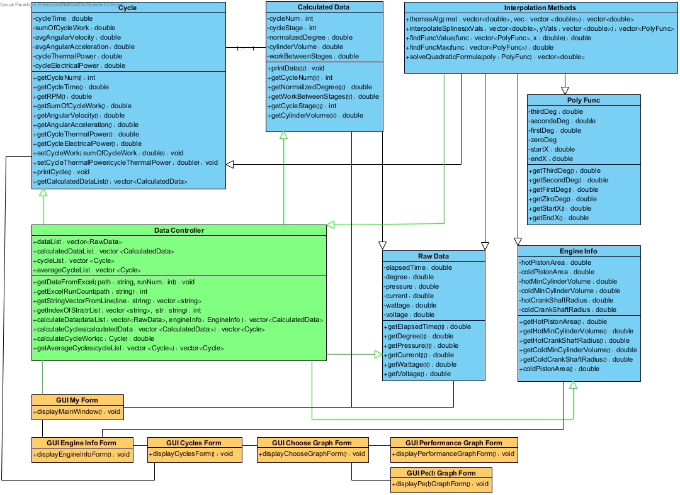
Class Diagram
Notes:
This is the class diagram, we have 3 different Entity Classes, we have the data class that holds values of the raw imported data from the excel file.
The CalculatedData class is a type of data with added values that we calculate in the first stage of calculations.
The cycle class contains a list of calculated data that belongs to a specific cycle, and calculated values including the thermal power that was mentioned in previous slides.
The DataController will contain all the calculation functions that are needed.
And the other classes belong to the graphic user interface.

Slide 25
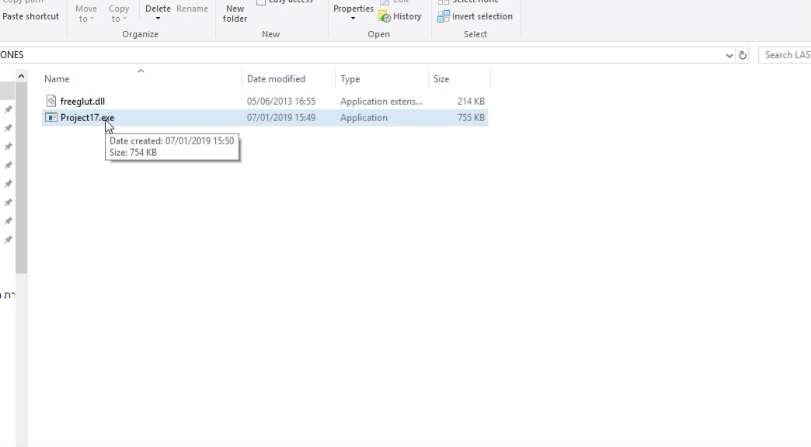
Graphic User Interface
Notes:
We press the choose file button, we find the experiment csv file and click it.
our program checks if the file and its format are valid and shows how many runs the experiment has.
We choose the run we want to import, and press calculate.
We get to the engine info form, we then need to insert the engine’s properties such as… and click calculate. Every engine has different properties and it affects the results.
In this form we can see average power for every RPM that was calculated for the engine performance graph.
Then we can choose a graph to display and it will interpolate the points to show us a more refined graph.

Slide 26
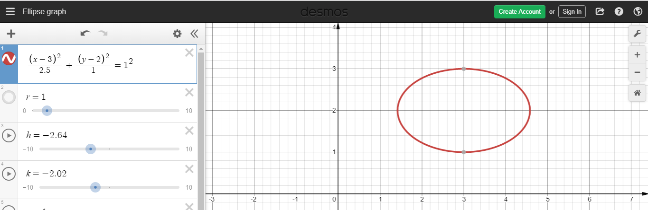
Interpolation Testing
Notes:
To test our interpolation method, we chose to run test on ellipses similar to our cycles, for example:
This is a function of the ellipse in the image, we choose 10 points on the ellipse and tried to calculate the area
Inside using different methods and only the 10 points.
We then compared the results to the actual area.

Slide 27
Results & Conclusions
We were able to achieve less than 0.2% calculating the area using Natural Spline Interpolation with the method previously discussed.
Riemann sum using given points | De Casteljau’s Algorithm | Natural Cubic Spline | Real
7.09 | 3.85 | 7.84 | 7.853 | Area
0.763 | 4 | 0.013 | 0.0 | Difference
9.6% | 51% | 0.17% | 0% | Error

Slide 28
Thank You For Listening!

